Slide 1







Deep Learning Bootcamp 2026

Slide 2
Agenda
Introduction to Python
Basic numerical libraries for ML
Break 15:30
Linear Regression
Exploratory data analysis
Linear regression with PyTorch (deep learning library)

Slide 3
Schedule
Event No. | Details
Event 1 24th Oct 2025 | Deep Learning Essentials Covers the basics of Python and necessary packages required for Deep Learning such as numpy, scipy, pandas etc.
Event 2 10th Nov 2025 | Deep Learning for Regression and Classification Will cover the basics of PyTorch, as well as how to use PyTorch for performing regression and classification tasks.
Event 3 17th Nov 2025 | Deep Learning for Images In this event, we will extend the classification using deep learning, specifically focusing on datasets involving images.
Event 4 TBD – Sem 2 – 2026 | Deep Learning for Sequence Data (text and time series) In this event, we will focus on using Deep Learning models for datasets involving sequences or temporal relations. We plan to cover examples from both text and time-series datasets.
Event 5 TBD – Sem 2 – 2026 | Reinforcement Learning This session will introduce Deep Reinforcement Learning techniques with some practical applications.

Slide 4
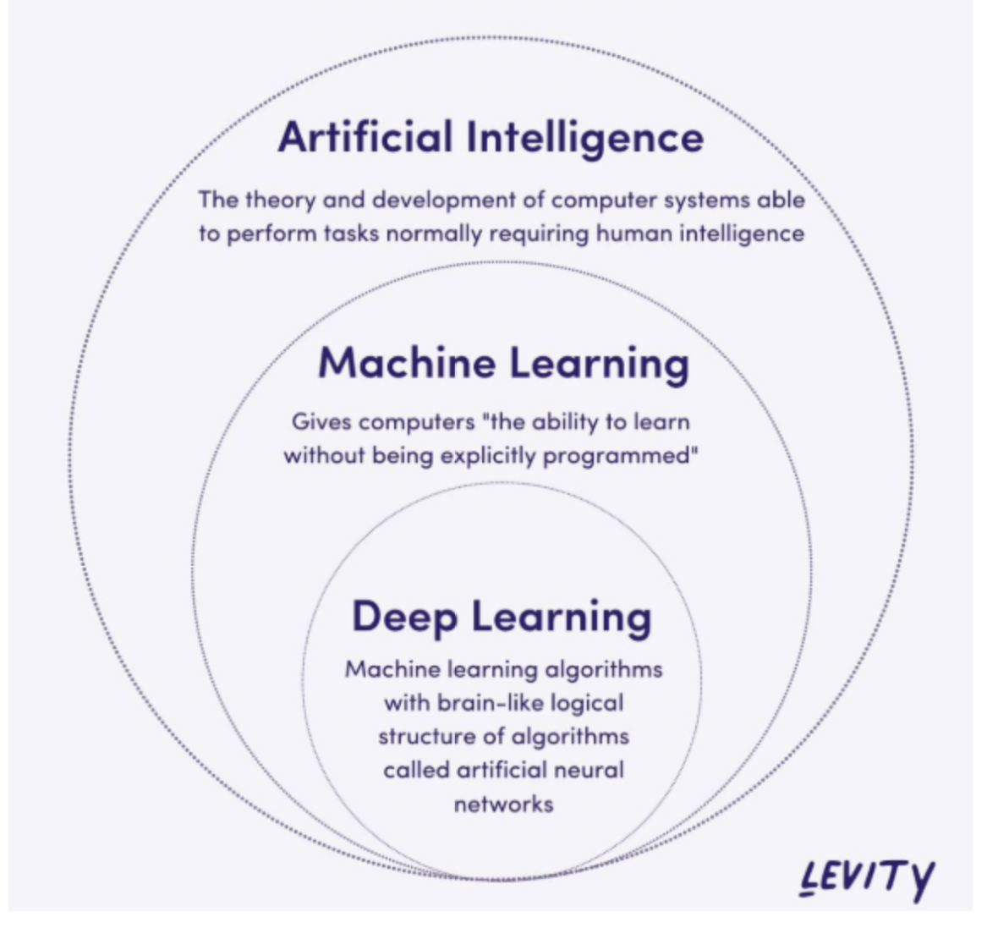
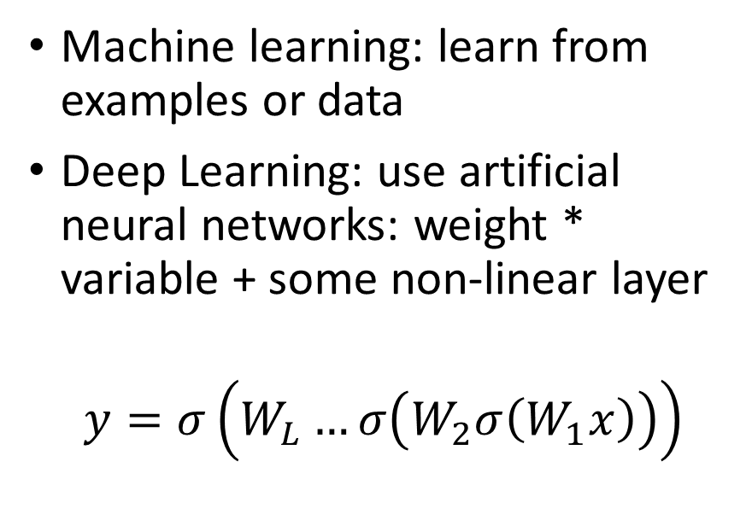
What is Deep Learning?
Machine learning: learn from examples or data
Deep Learning: use artificial neural networks: weight * variable + some non-linear layer
$$y=σ\left(W_{L}…σ\left(W_{2}σ\left(W_{1}x\right)\right)\right)$$

Slide 5
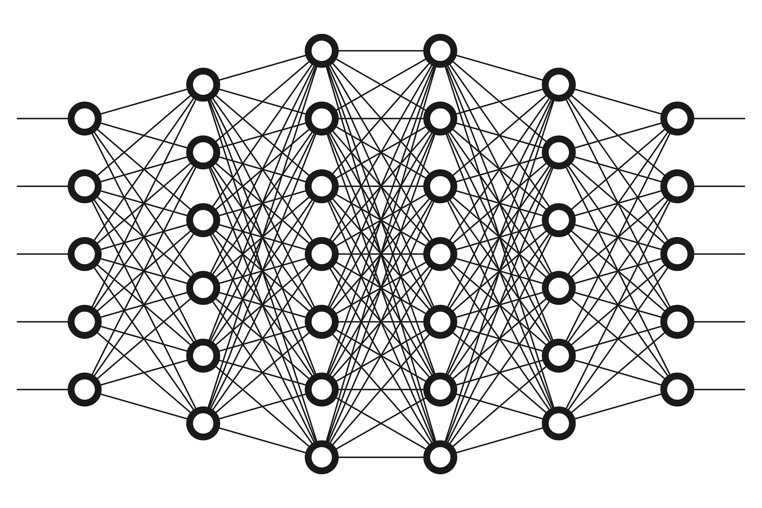
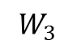
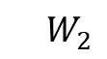
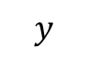
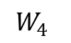

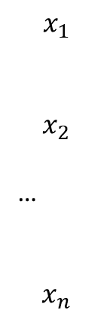
Deep Learning is powered by deep neural networks
$$x_{1}$$
$$x_{2}$$
…
$$x_{n}$$
Deep as in depth
i.e., many layers
$$y$$
$$W_{1}$$
$$W_{4}$$
$${ W}_{2}$$
$$W_{3}$$
https://cdn-images-1.medium.com/max/2400/1*1mpE6fsq5LNxH31xeTWi5w.jpeg

Slide 6
Why Deep Learning?
Find hidden patterns in a lot of data (high-dimensional, complex, etc.)
Many applications, open models
Material properties prediction
Protein folding: see AlphaFold
Text generation/Natural Language Processing: ChatGPT
Image generation: DALLE, MidJourney, etc.
Computer Vision: ImageNet, image segmentation, detect face in phone, etc.
…

Slide 7
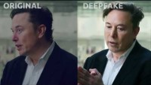
Deep Fakes…

Slide 8
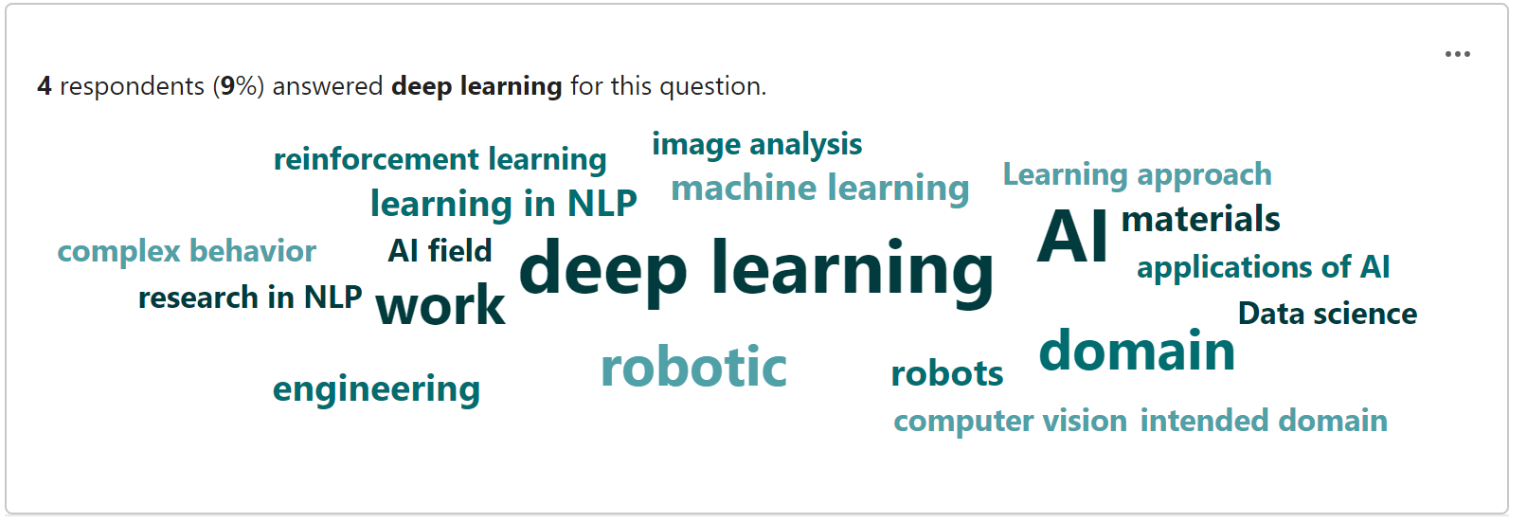
Your interest

Slide 9
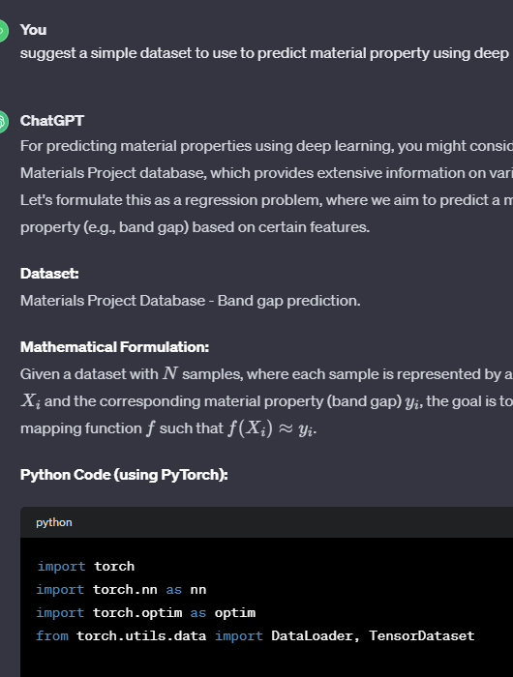
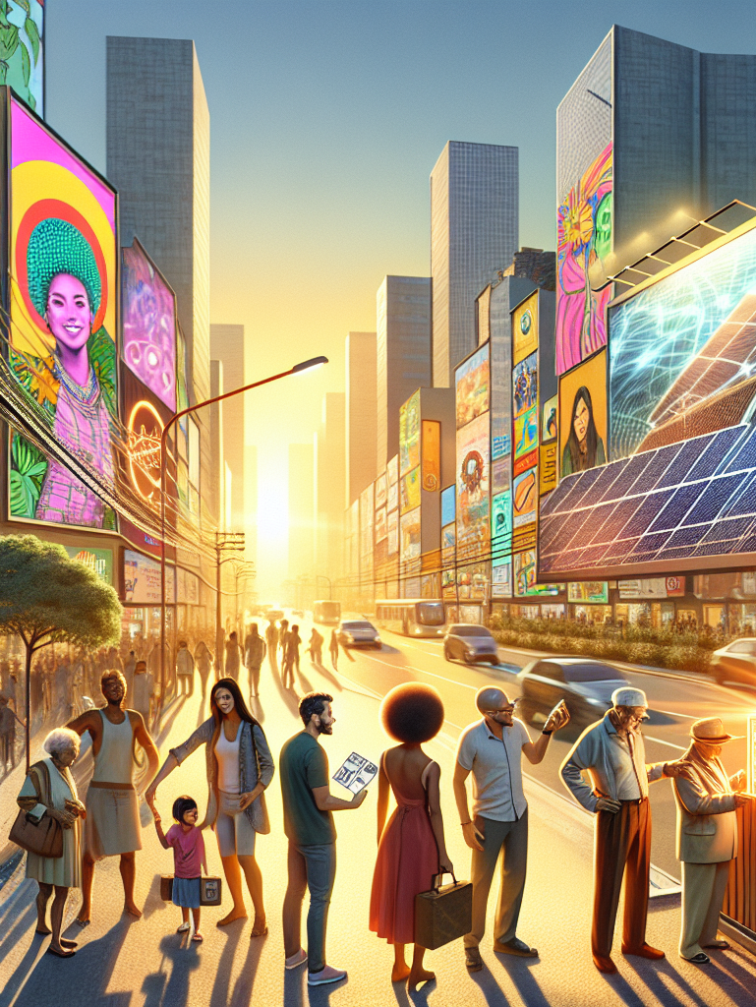
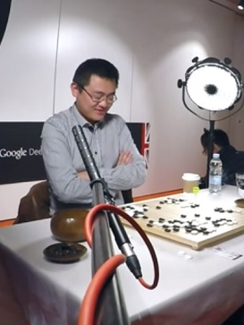
Examples

Slide 10
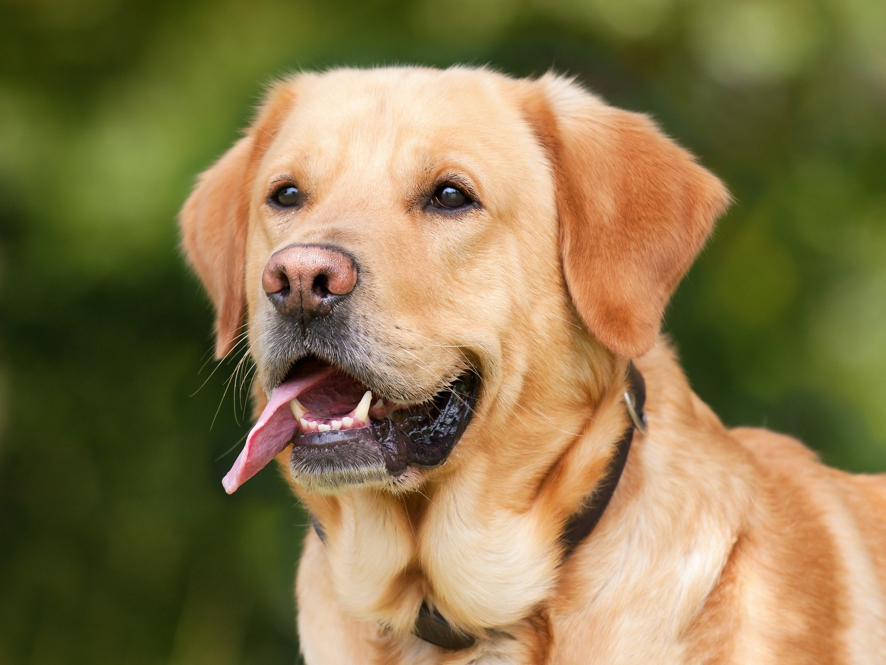
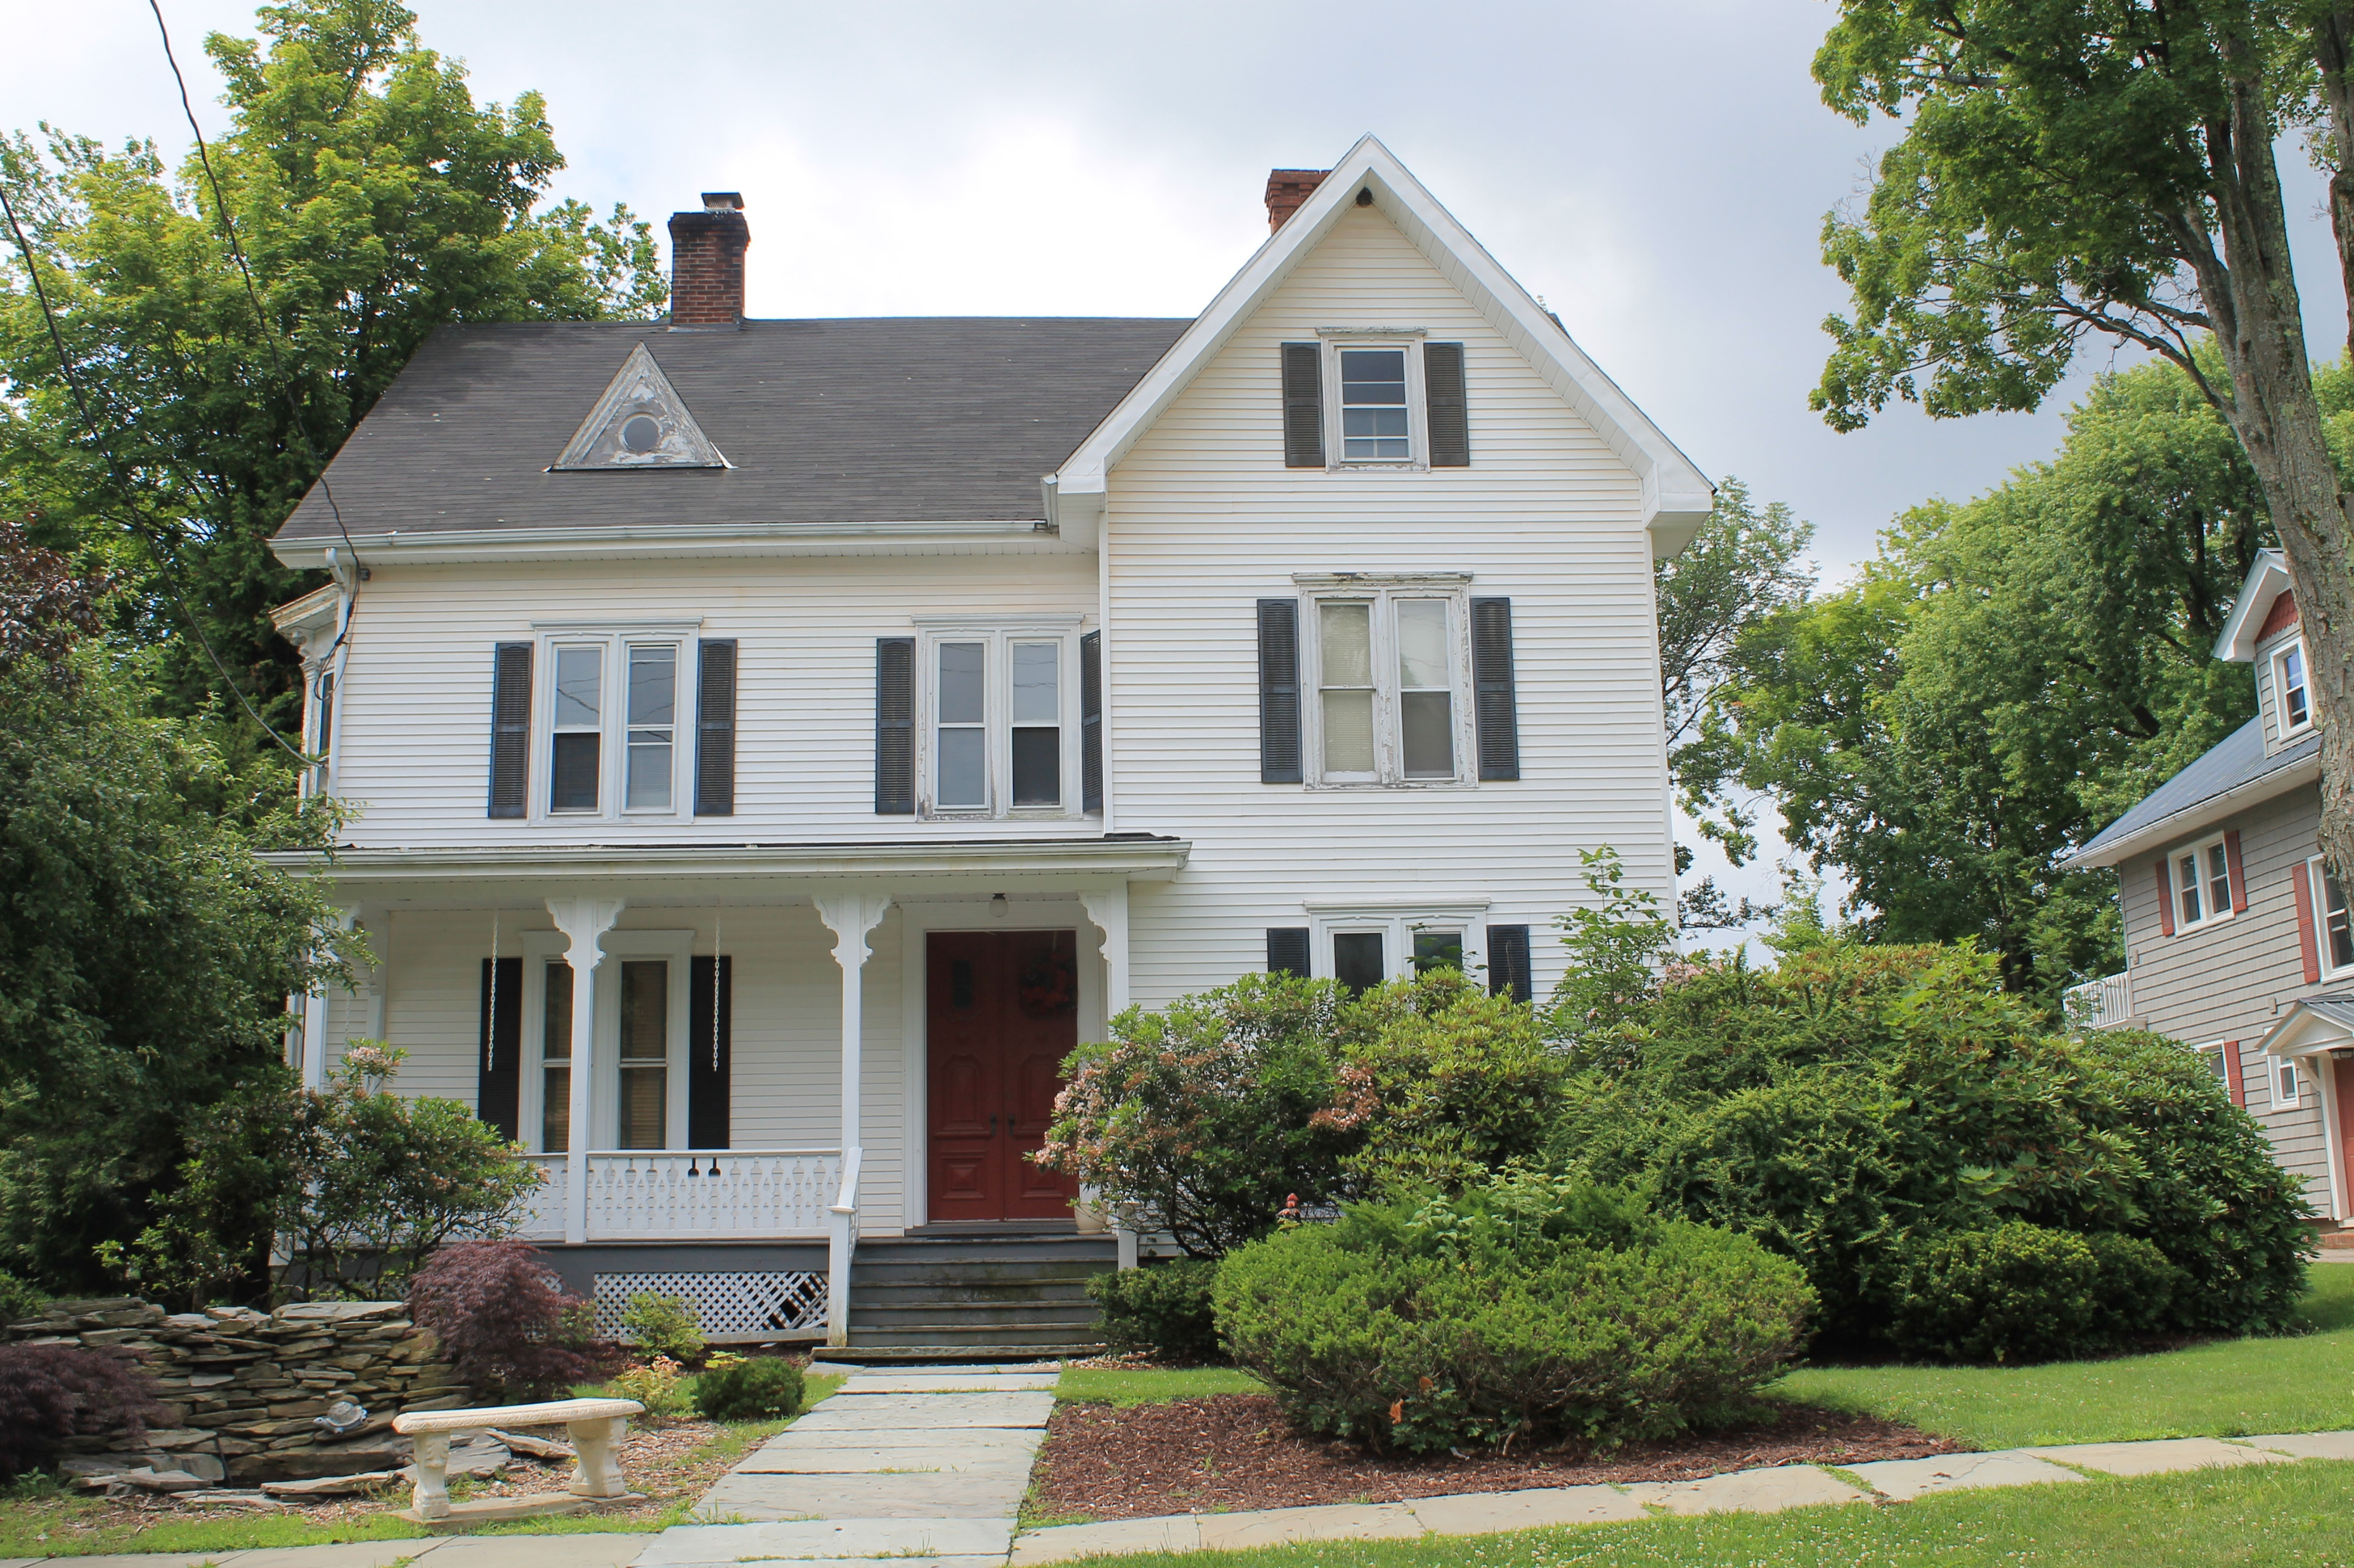
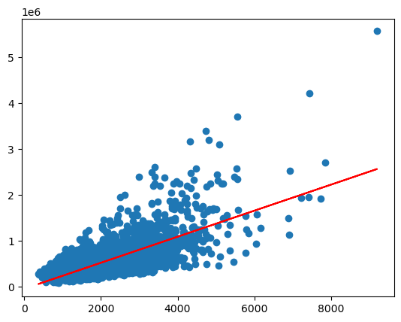
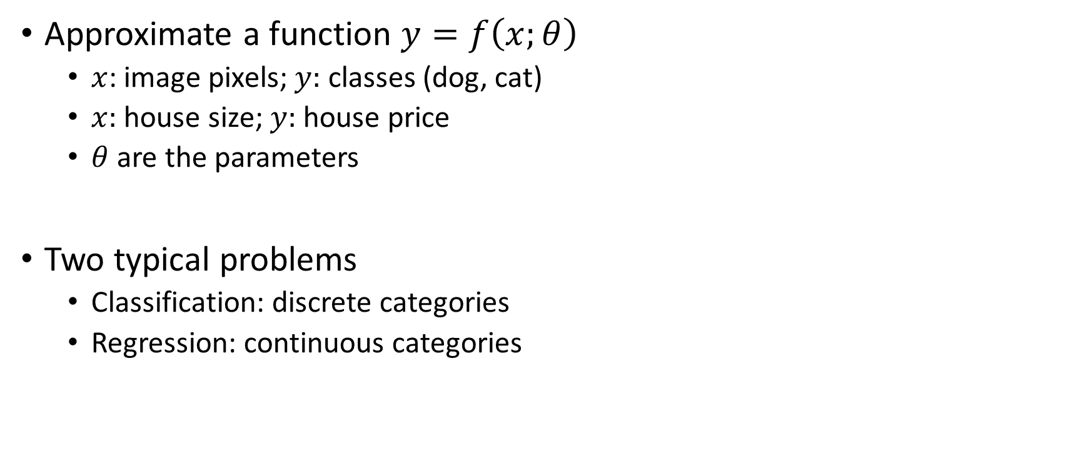
ML 101
Approximate a function $y=f\left(x;θ\right)$
$x$: image pixels; $y:$ classes (dog, cat)
$x:$ house size; $y:$house price
$θ$ are the parameters
Two typical problems
Classification: discrete categories
Regression: continuous categories

Slide 11
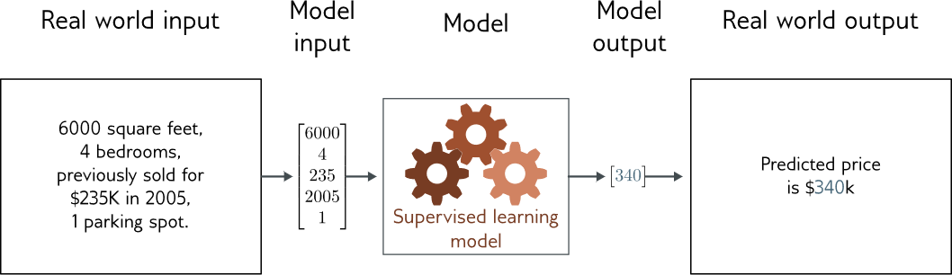
Regression
Univariate regression problem (one output, real value)
Fully connected network

Slide 12
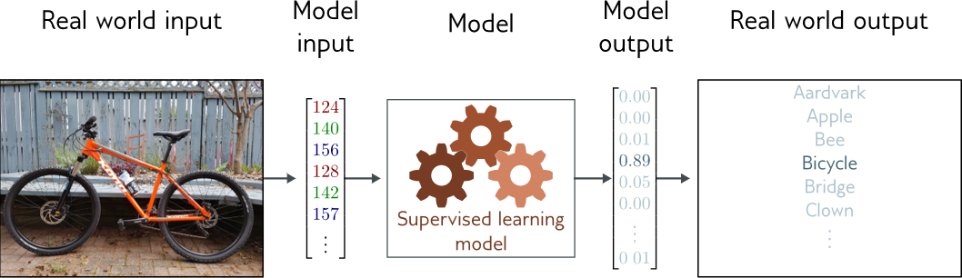
Classification
Multiclass classification problem (discrete classes, >2 possible classes)
Convolutional network

Slide 13
ML workflow
Training Data
Feature Extraction
ML model
Training
ML algorithm
Quality metric
Feature Extraction
ML model
Score
Test Data
Quality metric
Test
https://www.coursera.org/learn/ml-foundations?specialization=machine-learning

Slide 14
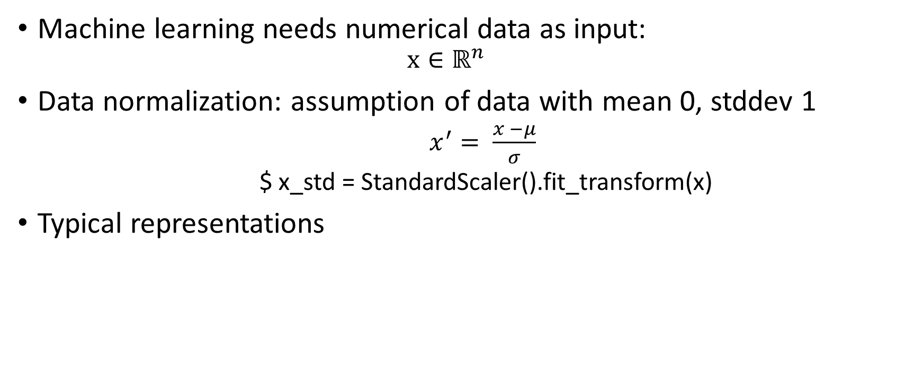
Feature Extraction 101
Machine learning needs numerical data as input:
$$x∈ℝ^{n}$$
Data normalization: assumption of data with mean 0, stddev 1
$x^{′}= \frac{x −μ}{σ}$
$ x_std = StandardScaler().fit_transform(x)
Typical representations
Data Type | Common Representation
Images | Pixel intensity arrays
Text | Word embeddings (Word2Vec, GloVe, BERT)
Audio | Spectrogram or MFCC features

Slide 15
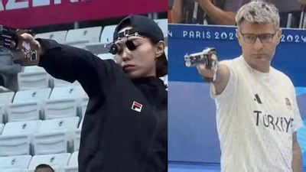
Model Selection 101
Many ML models to choose from:
Linear models: simple, interpretable, good baseline
Decision Trees / XGBoost: handle complex patterns, less linear assumptions
Neural Networks: powerful but need large data and tuning
Not every problem needs Deep Learning!
NNs can overfit on small datasets
Many hyperparameters, hard to tune
Require more computation and time
Model selection = experimentation
Try multiple models
Tune hyperparameters
Compare results using validation metrics (e.g., accuracy, RMSE, F1)
Pick the model that’s accurate, simple, and practical
ChatGPT for everything XGBoost

Slide 16
Pro & Cons of DL
Pro | Cons
Can learn features & representations easily Ability to process a lot of data Flexible framework Maps well into parallel hardware (GPU and others) | Hard to understand and build intuition of why the model works: explainability and interpretability Requires a lot of data and expensive hardware.

Slide 17
Work session 1.0

Slide 18
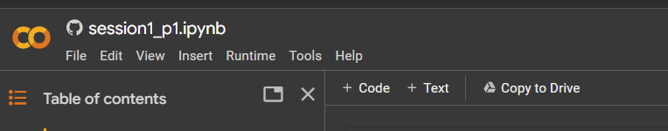

Google Colab: Our tool for today

Slide 19
Handling numbers & data: numpy
Numpy is library for handling array, vector & matrices
Provide all keys operations in arrays
Creation : a = np.array([[1, 2, 3], [4, 5, 6]])
Add/subtract/multiply: a + b, a – b, a * b, …
Dot product and matrix multiplication: a @ b
Slicing: a[1]=> [4,5,6]
Notes:
Overview of NumPy:
Definition: NumPy is a fundamental package for scientific computing in Python.
Purpose: It provides support for large, multi-dimensional arrays and matrices, along with mathematical functions to operate on these data structures.
Arrays in NumPy:
Definition: The core data structure in NumPy is the numpy.ndarray.
Creation: Arrays can be created using numpy.array() or specialized functions like numpy.zeros(), numpy.ones(), and numpy.arange().
Array Operations:
Element-wise Operations: NumPy allows element-wise operations on arrays.
Example: result = array1 + array2, where array1 and array2 are NumPy arrays.
Broadcasting: Arrays of different shapes can be combined in operations.
Example: Adding a scalar to an array.
Indexing and Slicing:
Indexing: Accessing individual elements in an array using indices.
Slicing: Extracting sub-arrays from a larger array.
Example: sub_array = array[start:stop:step].
Multi-dimensional Arrays:
Definition: NumPy supports multi-dimensional arrays (matrices).
Creation: Creating and manipulating matrices using NumPy.
Example: matrix = numpy.array([[1, 2], [3, 4]]).
Universal Functions (Ufuncs):
Definition: NumPy provides a set of mathematical functions that operate element-wise on arrays.
Example Ufuncs: numpy.sin(), numpy.cos(), numpy.exp(), etc.
Linear Algebra Operations:
Matrix Operations: NumPy supports standard linear algebra operations.
Example: numpy.dot() for matrix multiplication.
Random Module:
Purpose: NumPy includes a random module for generating random numbers and random arrays.
Example: numpy.random.rand().
Statistical Functions:
Mean, Median, Variance: NumPy provides functions for basic statistical calculations.
Example: numpy.mean(), numpy.median(), numpy.var().
Integration with PyTorch:
Compatibility: NumPy arrays can be easily converted to PyTorch tensors and vice versa.
Example: torch_tensor = torch.from_numpy(numpy_array).
Performance Benefits:
Vectorization: NumPy operations are often faster than equivalent operations using standard Python lists due to vectorization.
Documentation and Community:
Resources: Emphasize the availability of extensive documentation and a supportive community for learning and problem-solving.

Slide 20
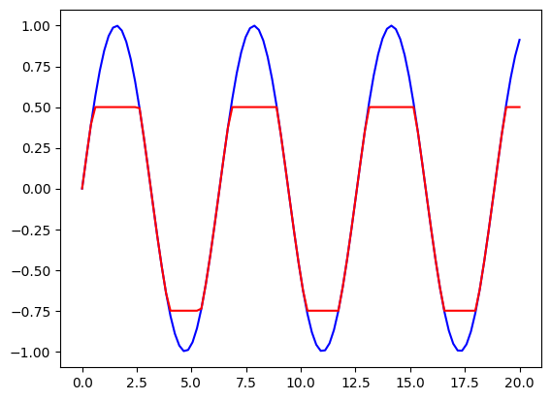
Plotting: matplotlib
Matplotlib is the Python library used to plot data
You can create easily different types of plots (scatter plot, histogram, X-Y plot), add legend and different details.

Slide 21
Python 101: Why Python?
A lot of libraries for ML/DL: PyTorch, scikit-learn, pandas, numpy
Easy to learn, simple syntax
Interactive notebooks: Jupyter Notebook, Kaggle, Google Collab
Free & open-source

Slide 22
Python 101: Basic features
MyModel: Class
Train: Function
Data
my_model: Data1
params: Data2
…
Data
def vowel_count(word):
vowels = ["a", "e", "i", "o", "u"]
count = 0
for char in word: # loops
if char in vowels: # conditions
count += 1
return count
vowel_count("hello")
Train: Function1
Test: Function2
…
?
Data
count
Notes:
-> What is value of count after vowel_count is executed?

Slide 23
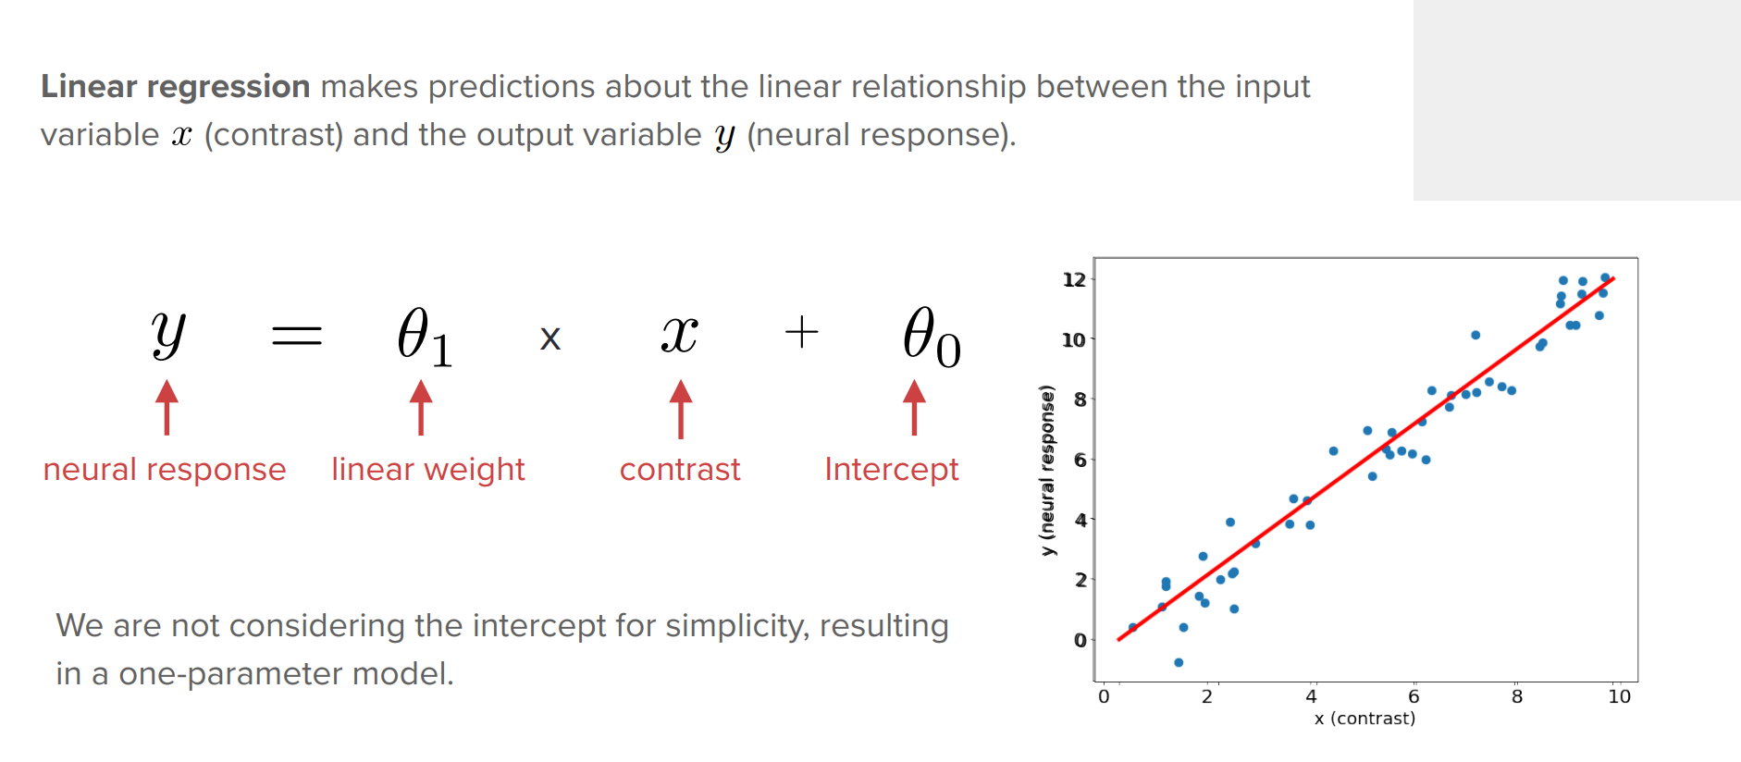
Linear Regression

Slide 24
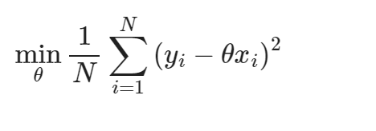
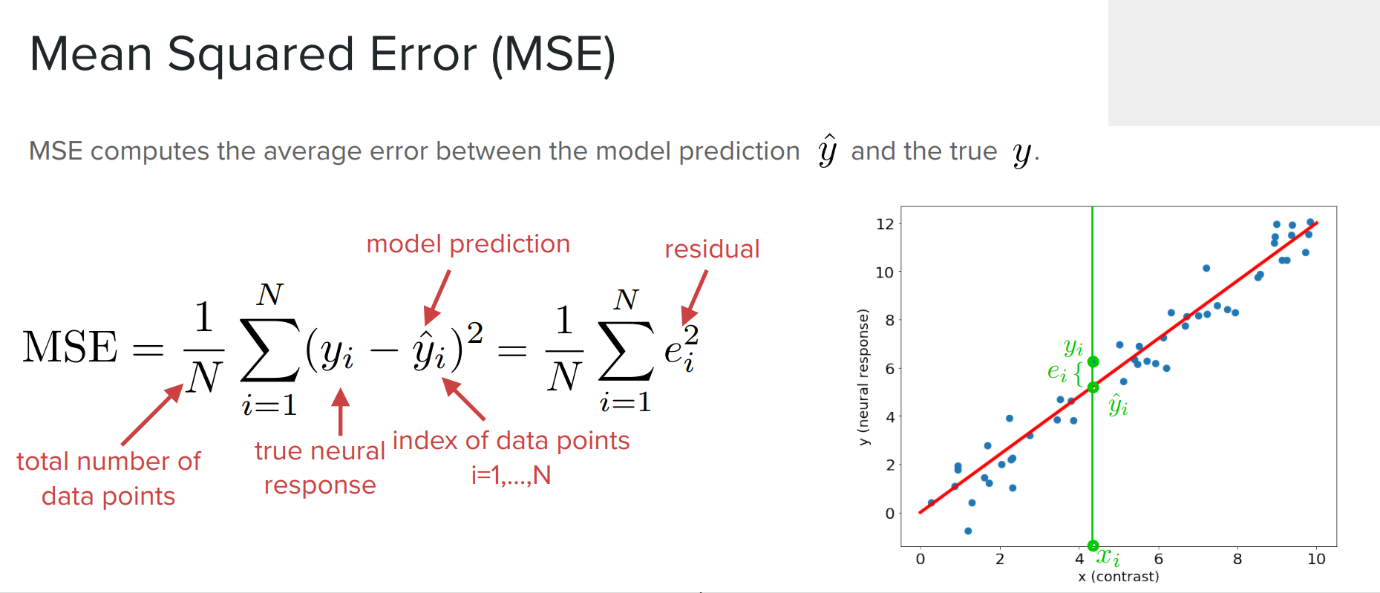
Linear Regression: MSE

Slide 25
Work session 2
How to Evaluate a Machine Learning Model (and Why It Matters)

Slide 26
Learning Objectives
Preparing data (inspection, visualization, train/test splits)
Building a machine learning model (Decision Tree)
Choosing metrics to assess model performance
Using the concept of bias–variance trade-off to tune hyperparameters
BONUS. Reducing variance using ensembling
Link to Colab: https://tinyurl.com/dlbs1p2

Slide 27
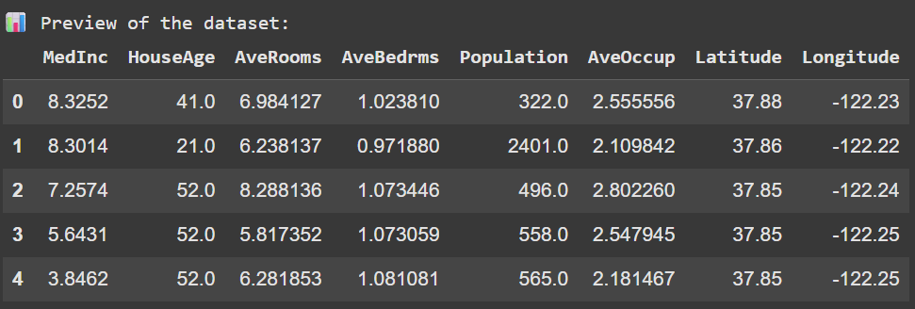
Preparing Data
California Housing Dataset

Slide 28
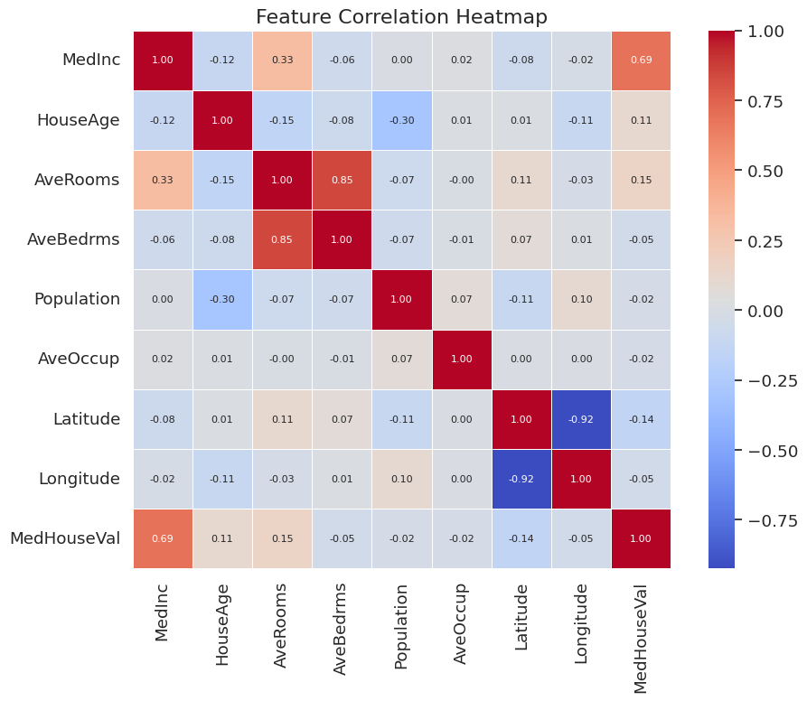
Activity 1
Q1. Which features are most correlated with the target?
Q2. Which features might be redundant or overlapping?

Slide 29
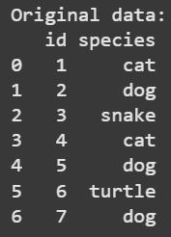
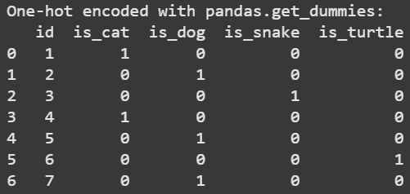
Transforming Data – One-Hot Encoding

Slide 30
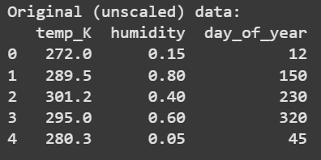
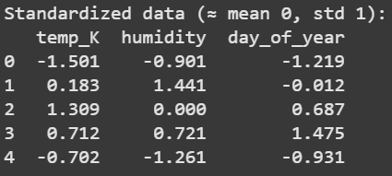
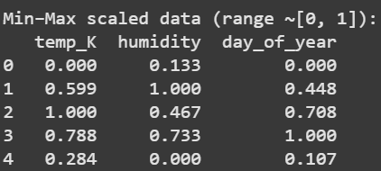
Transforming Data – Feature Scaling
Standardization
Min-Max Scaling

Slide 31
Splitting Data for Training and Testing
DATASET
TRAIN
TEST

Slide 32
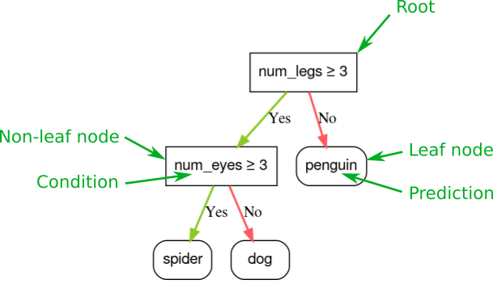
Choosing a Machine Learning Model – Decision Tree
https://developers.google.com/machine-learning/decision-forests/decision-trees

Slide 33
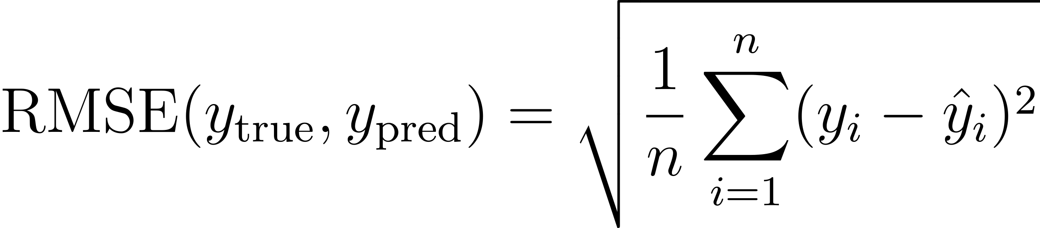
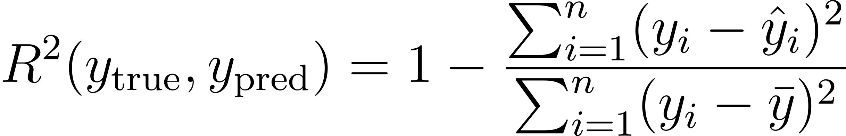
Model Evaluation Metrics – Regression
Activity 2. Write a function to compute RMSE for train and test splits

Slide 34
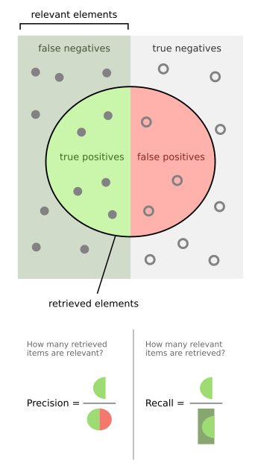
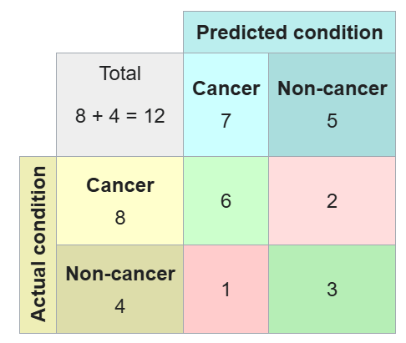
Model Evaluation Metrics – Classification

Slide 35
Hyperparameter Tuning
Hyperparameter. A setting you choose before training that controls how the model learns. It’s not learned from the data.
Decision tree hyperparameters:
max_depth → limits how many “levels” the tree can grow
min_samples_split → minimum samples required to split a node
min_samples_leaf → minimum samples required in any leaf criterion
Activity 3. Which max_depth is the best?

Slide 36
Splitting Data – Enter Validation Split
DATASET
TRAIN
TEST
TRAIN
VAL.
TEST

Slide 37
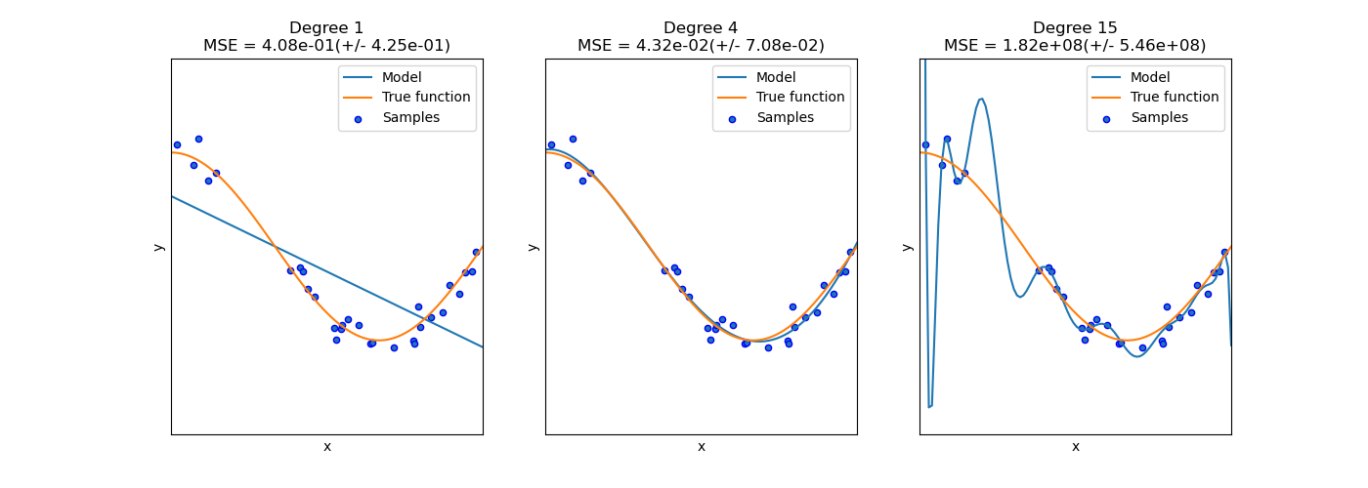
Bias-Variance Tradeoff
High bias
(Underfitting)
Good Fit
High Variance
(Overfitting)
https://scikit-learn.org/stable/modules/learning_curve.html

Slide 38
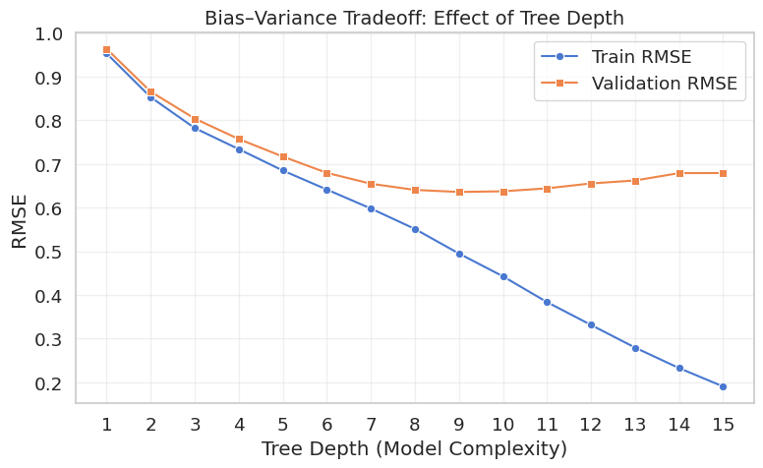
Validation Curves
Activity 4. Which max_depth is the best?

Slide 39
Summary
Blueprint of a Machine Learning Project
Define your prediction goal (classification/regression)
Explore and understand your dataset
Split the data into train/test/validation
Pick a model, train it, and measure its performance
Tune hyperparameters and optimize model through the lens of bias–variance trade-off.

Slide 40
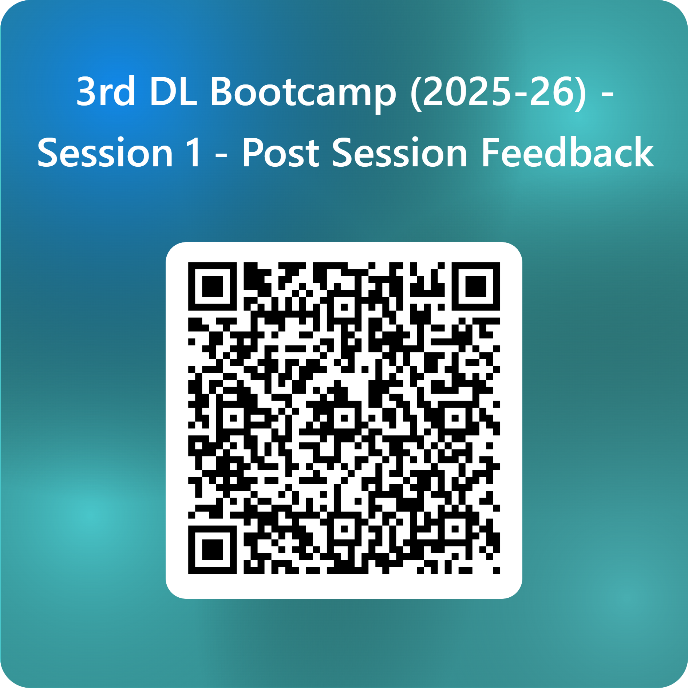
We’d love to hear your feedback Help us make the next session even better!

Slide 41
References / Reading
Python introduction: https://swcarpentry.github.io/python-novice-inflammation/
More on scientific python: https://lectures.scientific-python.org/
https://deeplearning.neuromatch.io/
NeuroMatch Academy: https://deeplearning.neuromatch.io/tutorials/W1D1_BasicsAndPytorch/chapter_title.html
Exploratory computing w/ Python: https://mbakker7.github.io/exploratory_computing_with_python/
https://udlbook.github.io/udlbook/
Reuse slides from there

Slide 42
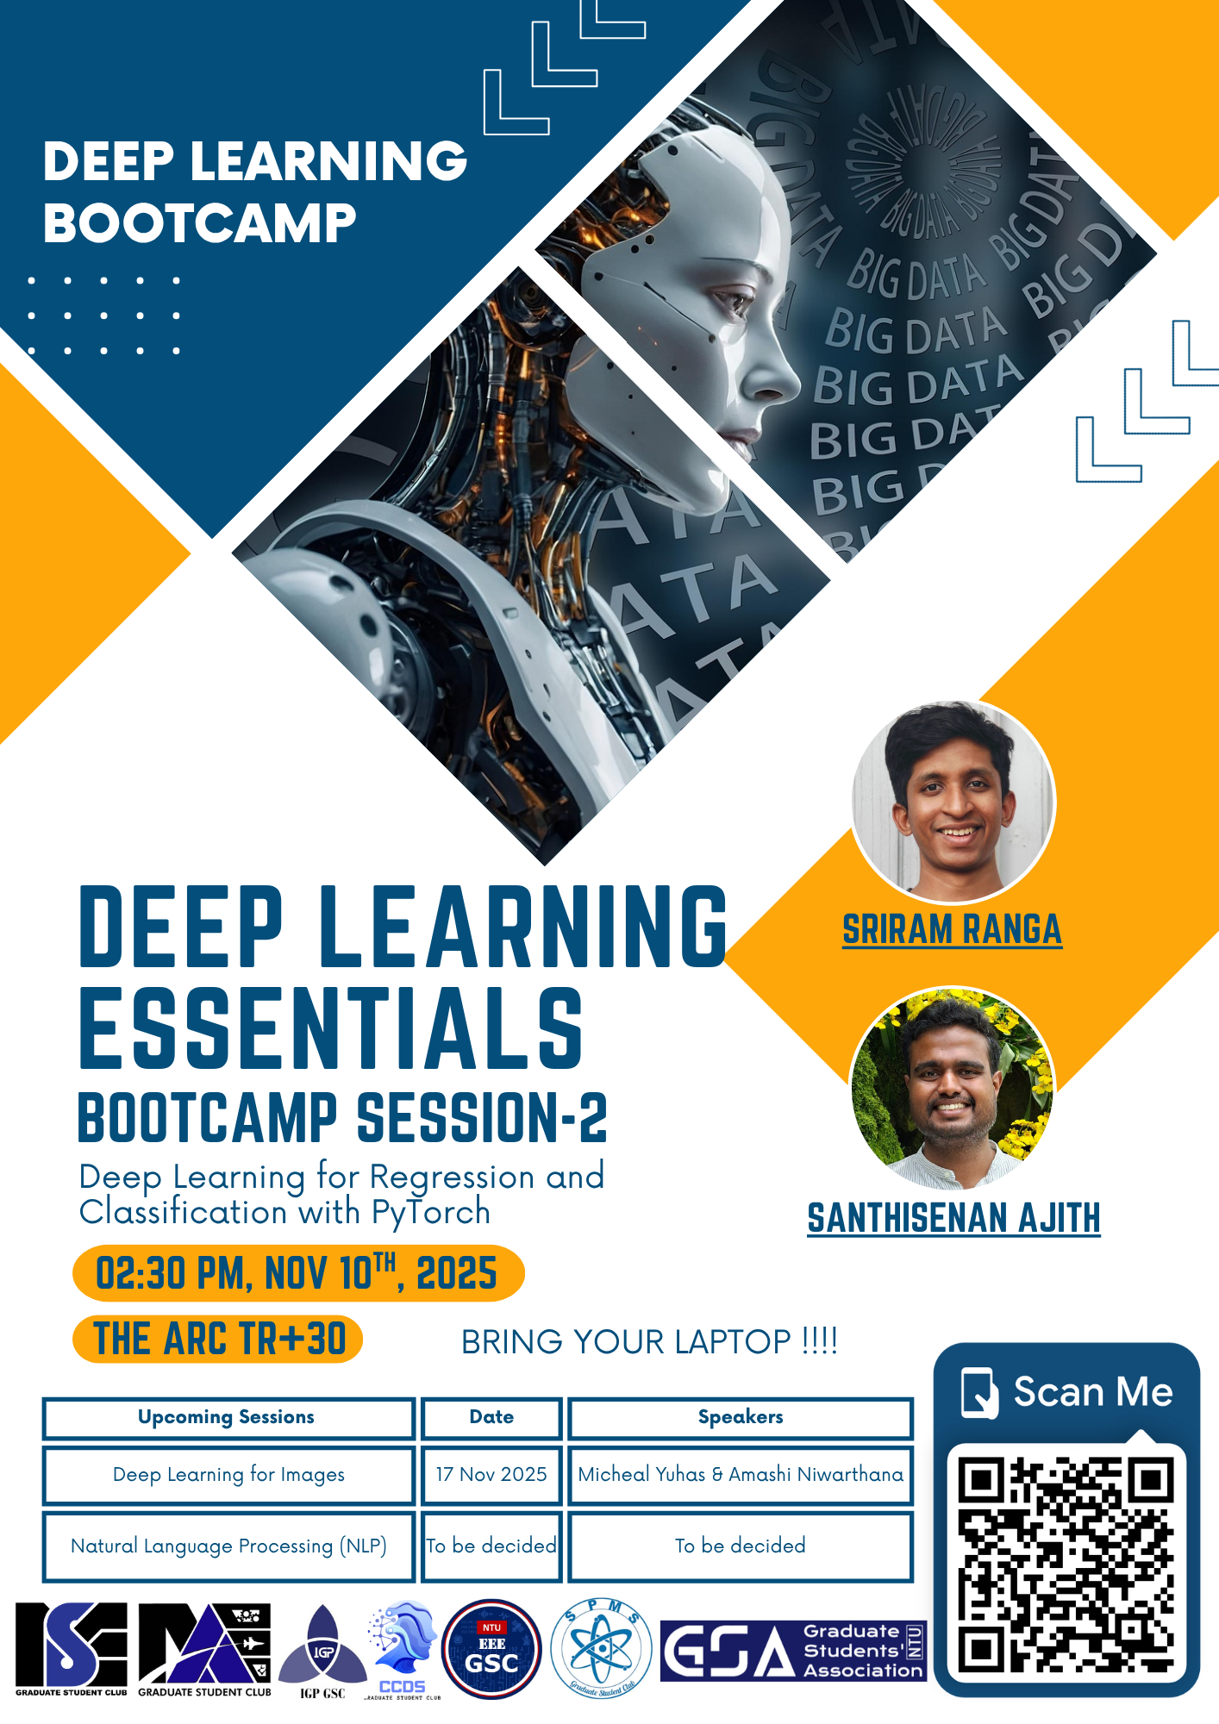
See you in the next session

